Slide 1

Git
- Nidhi Vaishnav

Slide 2
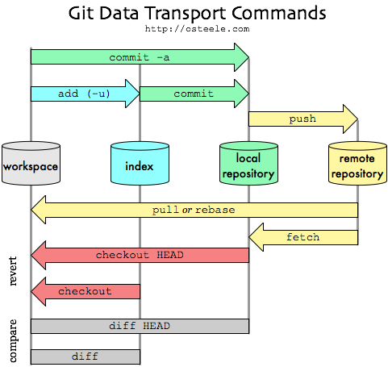
How git works?

Slide 3
How git works?
Initiate a new git local repository in your project (1 time for project)
Create a remote repository on GitHub (1 time for project)
Add remote origin link to local project (1 time for project)
Do coding (These files are in red color)
Add files ( files are added in the git index - green color)
commit changes (files are in local git version control)
Push (committed changes are pushed to remote repo.)
Pull (pull changes from remote)
Always check status after every git command

Slide 4
git init
to initialize git repository

Slide 5
git status
to see the current status of project in git;
It is good to check status time to time, sometimes changes occurs and you don’t notice

Slide 6
git add filename / git add *
When you add a new file or change the existing file in your project, it is untracked by git.
In this case, use git add command to add file in the git repository
Add file name with its extension
Untracked/modified files: red color
Added files: green color
To add everything, use * instead of file name

Slide 7
Git file status (not a command)
Staged
Files are ready to be committed
Unstaged
Files with changes that have not been prepared to be committed
Untracked
Files aren’t tracked by git yet. (newly created file)
Deleted
File has been deleted and is waiting to be removed from git

Slide 8
git commit –m “message”
To store the changes
More like a snapshot of our repository
If we ever need to look back at changes we have made, we can see the entire timeline
Note:
Always perform git status before and after commit
Perform git commit only after everything is added (green files)
Always write the message describing what changes you have made

Slide 9
git log
To check the commit history

Slide 10
git remote add origin link_of_online_git_repo
You don’t just want to keep the project on your local computer, right!
To put the project online, we use GitHub or GitLab.
Create a project repository on GitHub, link that project repository to your local project via this command

Slide 11
git push -u origin master
To tell the Git that we are ready to put all commits to origin repo (on GitHub)
Name of remote: origin
Default local branch: master
-u : parameter to tell Git to remember this command, so next time just git push will work

Slide 12
git pull
When working with many people on the same project, we can take their changes using this command
When working with many people, always use pull before push

Slide 13
Tutorial
https://try.github.io/levels/1/challenges/1

Slide 14
References:
https://try.github.io/levels/1/challenges/1
https://github.com/juanfrans/GSAPP-AP/wiki/Github-Basic-Commands-(Terminal)
http://osteele.com

